Slide 1
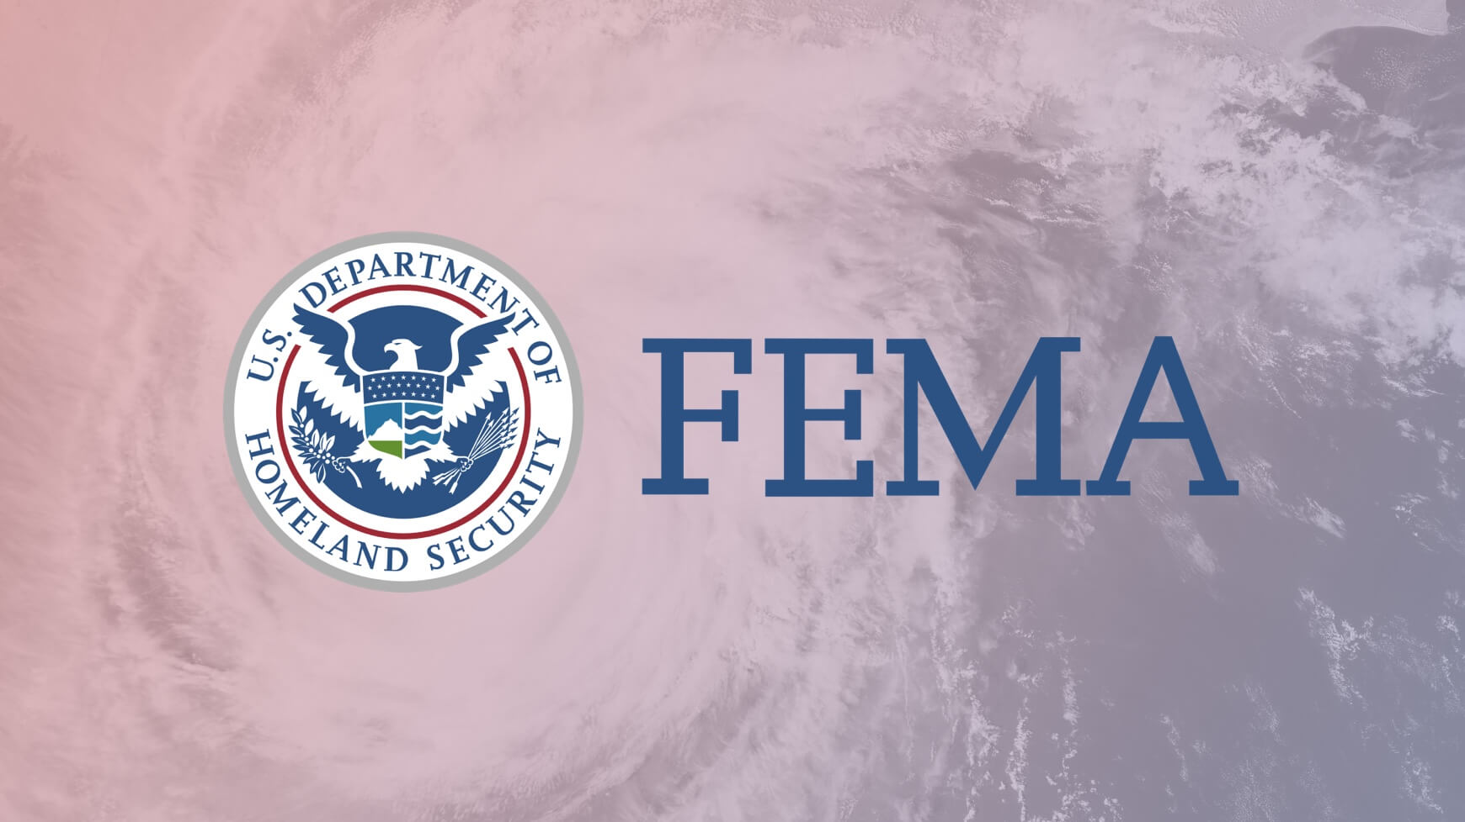
Hazard Mitigation Analysis using Regression Analysis
By: Rachel Beery

Slide 2
Problem Statement
Our client FEMA has tasked us with studying the success of hazard mitigation by analyzing hazard mitigation projects of the past and recovery projects to better allocate funds for future hazard mitigation projects

Slide 3
Data
There are two OpenFEMA datasets used in this analysis.
Hazard Mitigation project information is found in the first dataset
Features of importance include region, state, project amount, program fiscal year, benefit cost ratio, and net value benefits
Recovery project information is found in the second dataset
Features of importance include incident type, damage category, state, project amount, program year
Our modeling begins in 1999 when reporting began for recovery projects

Slide 4
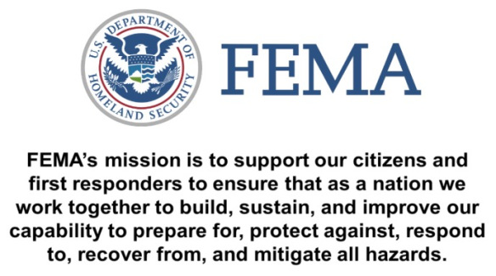

Slide 5
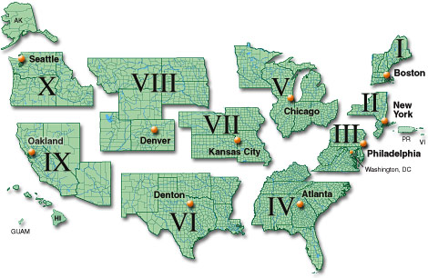

Slide 6
Mean Cost of Hazard Mitigation:
$815,798.37
Mean Cost of Recovery Project:
$191,772.47
Median Cost of Hazard Mitigation:
$114,895.50
Median Cost of Recovery Project:
$9,984.46

Slide 7
Recovery Projects

Slide 8
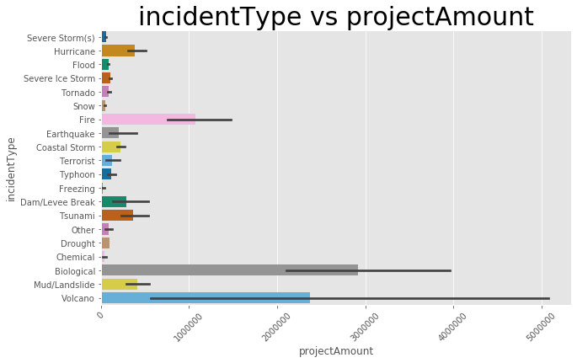

Slide 9
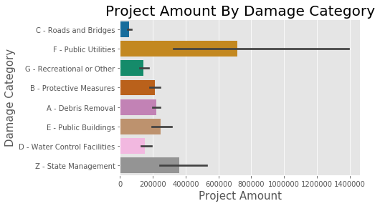

Slide 10
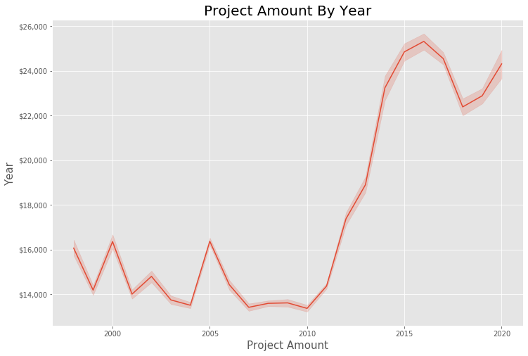
Notes:
Year was the most hughly correlated. As costs of recovery has increased more money should be spent in hazard mitigation

Slide 11
Hazard Mitigation

Slide 12
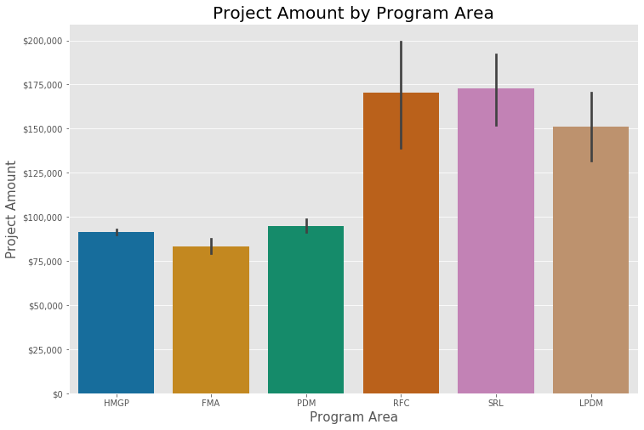
HMGP - Hazard Mitigation Grant Program
FMA - Flood Mitigation Assistance grant program,
PDM - Pre-disaster Mitigation grant program
RFC - Repetitive Flood Claims grant program
SRL - Severe Repetitive Loss grant program
LPDM -Legislative Pre-disaster Mitigation grant program
Notes:
FMA - Flood Mitigation Assistance grant program, HMGP - Hazard Mitigation Grant Program, LPDM -Legislative Pre-disaster Mitigation grant program, PDM - Pre-disaster Mitigation grant program, RFC - Repetitive Flood Claims grant program, SRL - Severe Repetitive Loss grant program

Slide 13
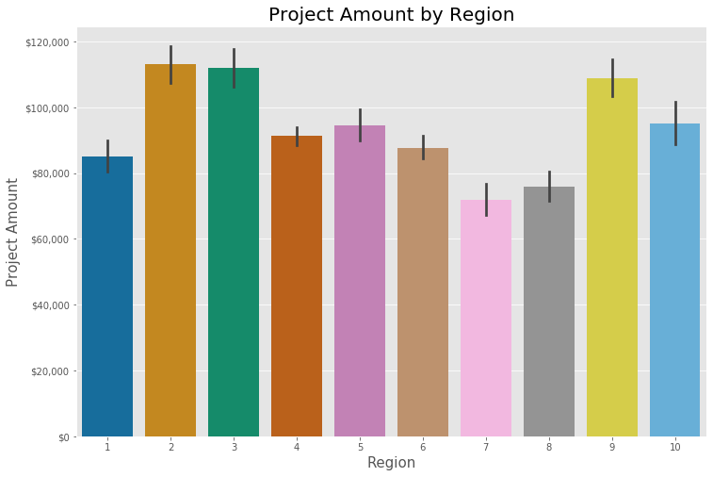
Notes:
States including alaska, dc, arizona, louisiana, puerto rico, idaho
Region 1 Connecticut | Maine | Massachusetts | New Hampshire | Rhode Island | Vermont
Region 2 New Jersey | New York | Puerto Rico | Virgin Islands
Region 3 Delaware | Maryland | Pennsylvania | Virginia | District of Columbia | West Virginia
Region 4 Alabama | Florida | Georgia | Kentucky | Mississippi | North Carolina | South Carolina | Tennessee
Region 5 Illinois | Indiana | Michigan | Minnesota | Ohio | Wisconsin
Region 6 Arkansas | Louisiana | New Mexico | Oklahoma | Texas
Region 7 Iowa | Kansas | Missouri | Nebraska
Region 8 Colorado | Montana | North Dakota | South Dakota | Utah | Wyoming
Region 9 Arizona | California | Hawaii | Nevada | Guam | American Samoa | Commonwealth of Northern Mariana Islands | Republic of Marshall Islands | Federated States of Micronesia
Region 10 Alaska | Idaho | Oregon | Washington

Slide 14
Recommendations
Hazard Mitigation
More funds should be allocated to hazard mitigation in all categories as natural disasters and subsequently recovery are increasing
Recovery
Budgets should be analyzed to understand what regions of the U.S. should receive more funding over other regions with higher risk to natural disaster costs
Alaska, DC, Arizona, Louisiana, Puerto Rico, Idaho
Coastal areas need more funding than those of the Mid West
Less common Natural Disaster Preparedness
The costs of COVID-19 surpass all categories of natural disaster recovery costs
Volcanoes were second highest cost even though they are less common natural disaster

Slide 15
Future Work
Research less common natural disasters including biological
Budgets in Hazard Mitigation Project Areas
HMGP - Hazard Mitigation Grant Program
FMA - Flood Mitigation Assistance grant program,
PDM - Pre-disaster Mitigation grant program
RFC - Repetitive Flood Claims grant program
SRL - Severe Repetitive Loss grant program
LPDM -Legislative Pre-disaster Mitigation grant program
Funding allocation
Community Preparation

Slide 16
Thank you!
Data provided by FEMA at the following website:
https://www.fema.gov/openfema-data-page/disaster-declarations-summaries-v2

Slide 17
Appendix

Slide 18
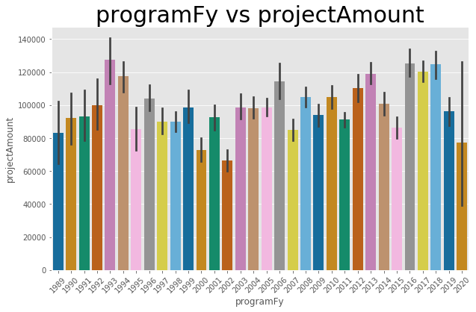
Hazard Mitigation

Slide 19
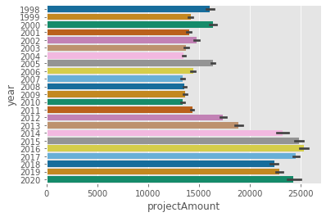
Recovery

